Slide 1
PRESENTER GUIDELINES
Kindly prepare the following:
Extended abstract
 the format is provided on the website. Please see the deadline on the flyer.
The presentation is 3MT® (Three Minute Thesis) pitching followed by poster presentation. The presenters shall prepare a 3MT® slide and research poster of their work.
One 3MT®-slide (16:9 aspect ratio) using this PPT template
 Please see the next page for submission information.
Please see the deadline on the flyer.
Electronic poster (16:9 aspect ratio)
 Please bring your device and a connector. TV is provided.

Slide 2
Please leave this box alone!
Please use this template for the 3MT slide.
Please do not alter the layout.
When done, please convert this 1-page slide to a pdf file,
and submit it to the link below by the date specified on the flyer.
https://chula-my.sharepoint.com/:f:/g/personal/wid_m_chula_ac_th/EqtD-1oaJDJApTffqeYzfwgBn-RY4ImbIF9v7w3ITPcRPg

Slide 3
WHAT IS 3MT™ ANYWAY?
The presentation format is 3MT™ or "Three Minute Thesis" presentation.
In this format, you should be able to convey your research in a clear and engaging manner to audience with little to no background about your study; all in 2:30 to 3 min.
We hope to develop your academic presentation, research communication skills, and confidence with this feat. The key is to make it simple yet complete.
Still unclear and unsure? Here are some example winning 3MT presentations.
"Suspects, Science and CSI" by Matthew Thompson from the University of Queensland - https://www.youtube.com/watch?v=pvjPzsLIyGw&t=62s
"Mosquito research: saving lives with pantyhose and paperclips" by Emily Johnston from the University of South Australia - https://www.youtube.com/watch?v=dh0pJdgY6Lc
"Using Stem Cells to Model and Treat Cardiovascular Diseases" by Matthew Ellis from Yale University - https://www.youtube.com/watch?v=Q-0os7z7aJ4&t=8s
Good luck and go win that 3MT™!

Slide 4
3MT™ SLIDE
3MT™ slide is similar to a graphical abstract found in research article.
IT IS NOT THE SAME WITH YOUR POSTER!
It should give a clear overview of your research, at the same time, engaging and appealing to the audience.
Your creativity is your limit! You can stick to the classical scientific graphic styles or even use memes to convey your message (as long as it delivers your message).
Most 3MT™ slide just show the highlight of your research.
  No detailed results
  Not too much words
  Not too much figures
  No need to put names or any affiliations on the 3MT slide.

Slide 5
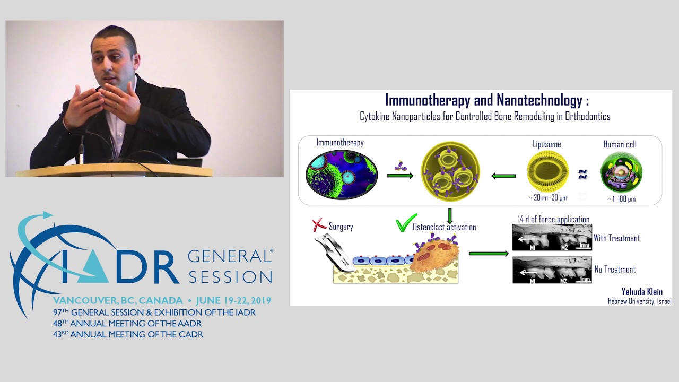
SAMPLE 3MT™ SLIDE
https://www.iadr.org/awards/three-minute-thesis-3mtr

Slide 6
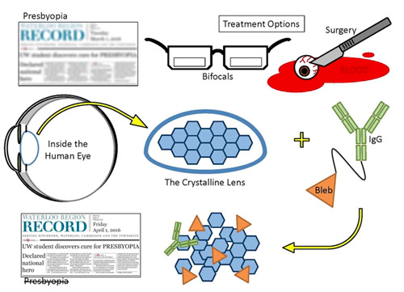
SAMPLE 3MT™ SLIDE
https://uwaterloo.ca/news/treatment-restore-nearby-vision-winner-waterloo-phd-student

Slide 7
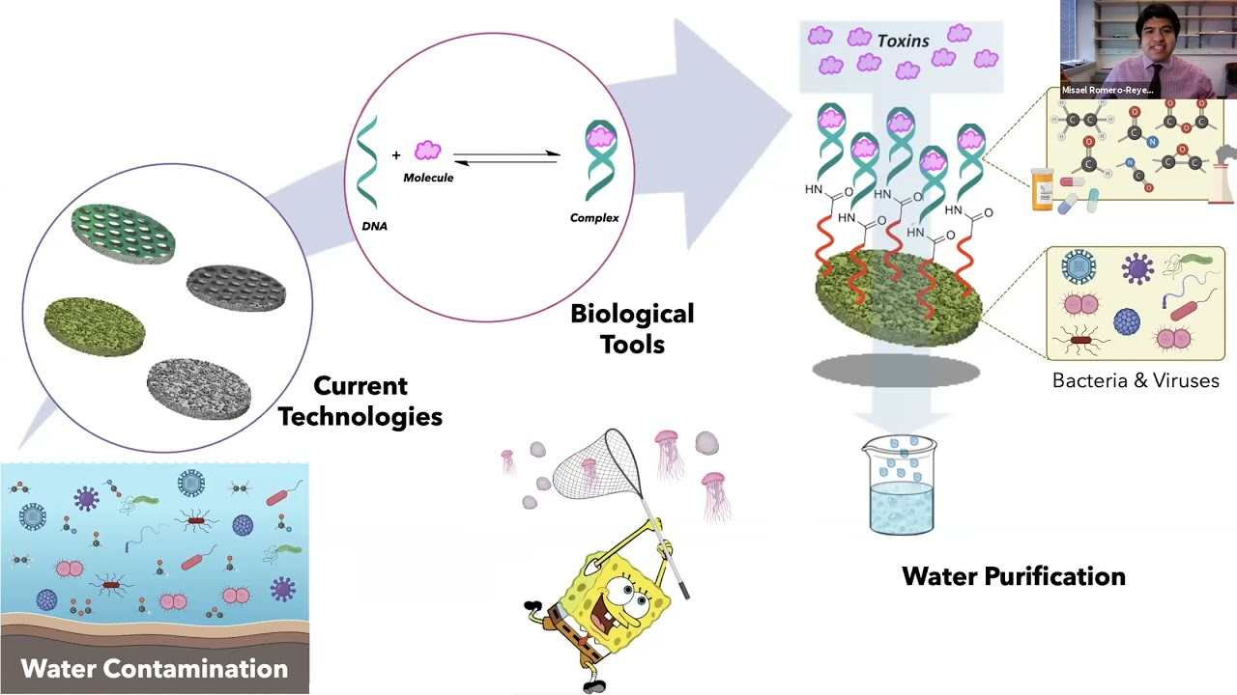
SAMPLE 3MT™ SLIDE
2021 Three-Minute Thesis (3MT) Competition Winner | Misael Romero-Reyes - https://www.youtube.com/watch?v=d8lUucQ9GGc

Slide 8
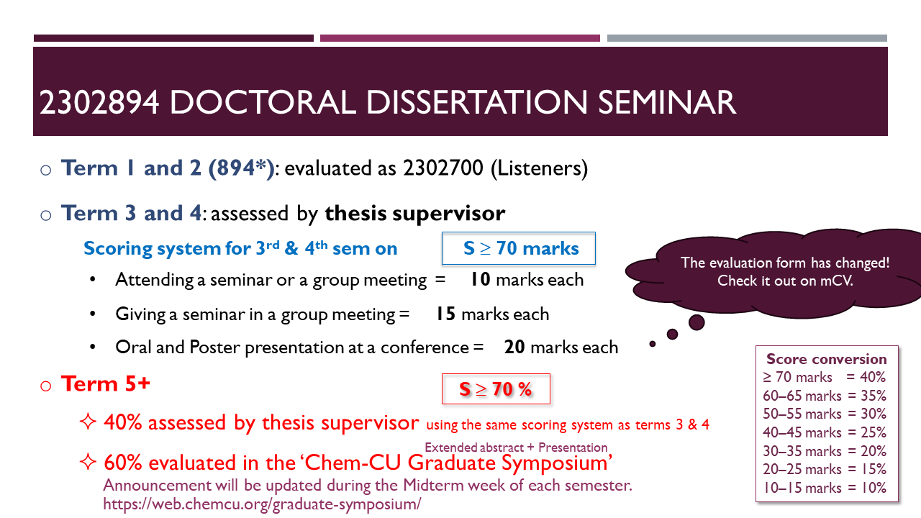
This is for CHEMISTRY program only, NOT GCS!

