Slide 2
PRESENTER GUIDELINES
The format for this year’s symposium is 3MT™ (Three Minute Thesis) competition followed by poster presentation. The presenters shall prepare a 3MT™ slide and research poster for their study.
Kindly prepare the following:
One 3MT™-slide (4:3 aspect ratio) using this PPT template (see last slide)
Electronic poster (16:9 aspect ratio)
Both in PDF file
Important Dates:
By Monday, 15 May 2023, please send the 3MT™ slide, to be collated and arranged by session and sequence.

Slide 3
WHAT IS 3MT™ ANYWAY?
This year's presentation format is 3MT™ or "Three Minute Thesis" presentation. In this format, you should be able to convey your research in a clear and engaging manner to audience with little to no background about your study; all in 180 seconds. We hope to develop your academic presentation, research communication skills, and confidence with this feat. The key is to make it simple yet complete.
Still unclear and unsure? Here are some example winning 3MT presentations.
"Suspects, Science and CSI" by Matthew Thompson from the University of Queensland - https://www.youtube.com/watch?v=pvjPzsLIyGw&t=62s
"Mosquito research: saving lives with pantyhose and paperclips" by Emily Johnston from the University of South Australia - https://www.youtube.com/watch?v=dh0pJdgY6Lc
"Using Stem Cells to Model and Treat Cardiovascular Diseases" by Matthew Ellis from Yale University - https://www.youtube.com/watch?v=Q-0os7z7aJ4&t=8s
Good luck and go win that 3MT™!

Slide 4
3MT™ SLIDE
3MT™ slide is similar to a graphical abstract found in research article. IT IS NOT THE SAME WITH YOUR POSTER!
It should give a clear overview of your research, at the same time, engaging and appealing to the audience.
Your creativity is your limit! You can stick to the classical scientific graphic styles or even use memes to convey your message (as long as it delivers your message).
Most 3MT™ slide just show the highlight of your research.
No detailed results
Not too much words
Not too much figures
No need to put names or any affiliations on the 3MT slide. You will be introduced by the MC along with a separate introduction slide per participant.

Slide 5
SAMPLE 3MT™ SLIDE
https://www.iadr.org/awards/three-minute-thesis-3mtr

Slide 6
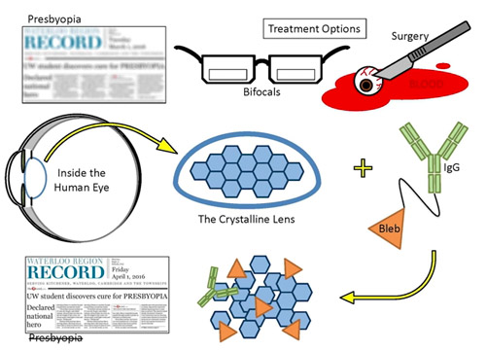
SAMPLE 3MT™ SLIDE
https://uwaterloo.ca/news/treatment-restore-nearby-vision-winner-waterloo-phd-student

Slide 7
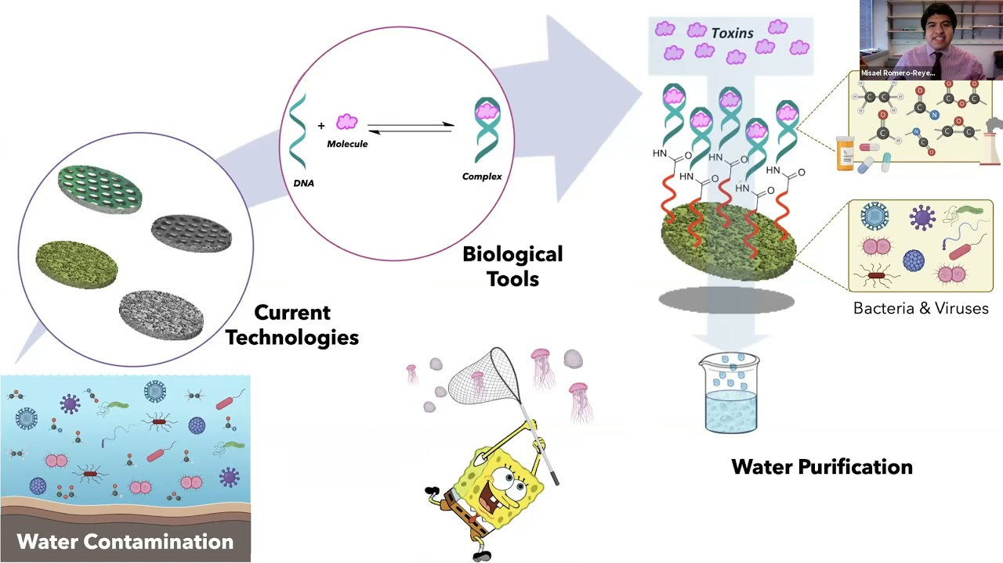
SAMPLE 3MT™ SLIDE
2021 Three-Minute Thesis (3MT) Competition Winner | Misael Romero-Reyes - https://www.youtube.com/watch?v=d8lUucQ9GGc

Slide 8
Please leave this box alone!
Please use this template for the 3MT slide.
Please do not alter the layout.
When done, please convert this 1-page slide to pdf file,
And submit it to the link below By Monday, May 5th.
3MT Slide Submission
https://tinyurl.com/ChemCU-3MT

